Slide 1
Microprocessor Control Logic - 2 Load and Jump Instructions The task in this assignment is to enhance the control logic to implement a load and a jump instruction

Slide 2
For the load instruction,data out from RAM has been connected to register file input.
In order to enable above input to register file (instead of usual input from ALU) when a load instruction is being executed, the sel input of the register file is used, which is supplied by the control logic.
For the jump instruction, bits in the instruction (IR) that represent the jump offset are connected to the offset input of the PC module, whose sub input is derived from the jump output supplied by the control logic.
Only the sub input is used (and not the add input) since the jump is backwards only (offset is subtracted from PC).
Also, the jump occurs only if the cout output of the ALU is high, ensured by AND of cout with jump in mproc module to generate sub.

Slide 3
The load instruction occupies two 16-bit words, the first of which specifies the address of the register (wr_addr) into which the data is to be loaded,while the second contains the 16-bit data to be loaded.
The jump instruction specifies an 8-bit offset. If cout is 1, then the offset is subtracted from the PC, else the next instruction is executed.

Slide 4
Note that while ALU and jump instructions execute in two clock cycles, the load instruction (which loads a 16-bit word from memory) would require three clock cycles to execute.
As a result, the FSM in the control logic would have three states.
Only contents of control_logic module need to be modified (from what you did in assignment 5) in this assignment.
As mentioned above, the control logic now needs to supply two more outputs (compared to assignment 5 control logic) sel and jump, which are to be asserted (for one or more clock cycles) during the load and jump instructions respectively.
Also note that the logic used to generate pc_inc inside the control logic needs to change.
Previously, pc_inc was asserted for only one of the three clock cycles required to execute an instruction, but for the load instruction pc_inc needs to be asserted twice in three clock cycles.

Slide 5
Note that even while executing a jump instruction, PC increment should be allowed to happen followed by offset
subtract from PC (if cout is 1).
Also, the inc and sub inputs to PC cannot be high at the same time, so the jump output of control logic (used to generate sub input to PC) must be accordingly generated.

Slide 6
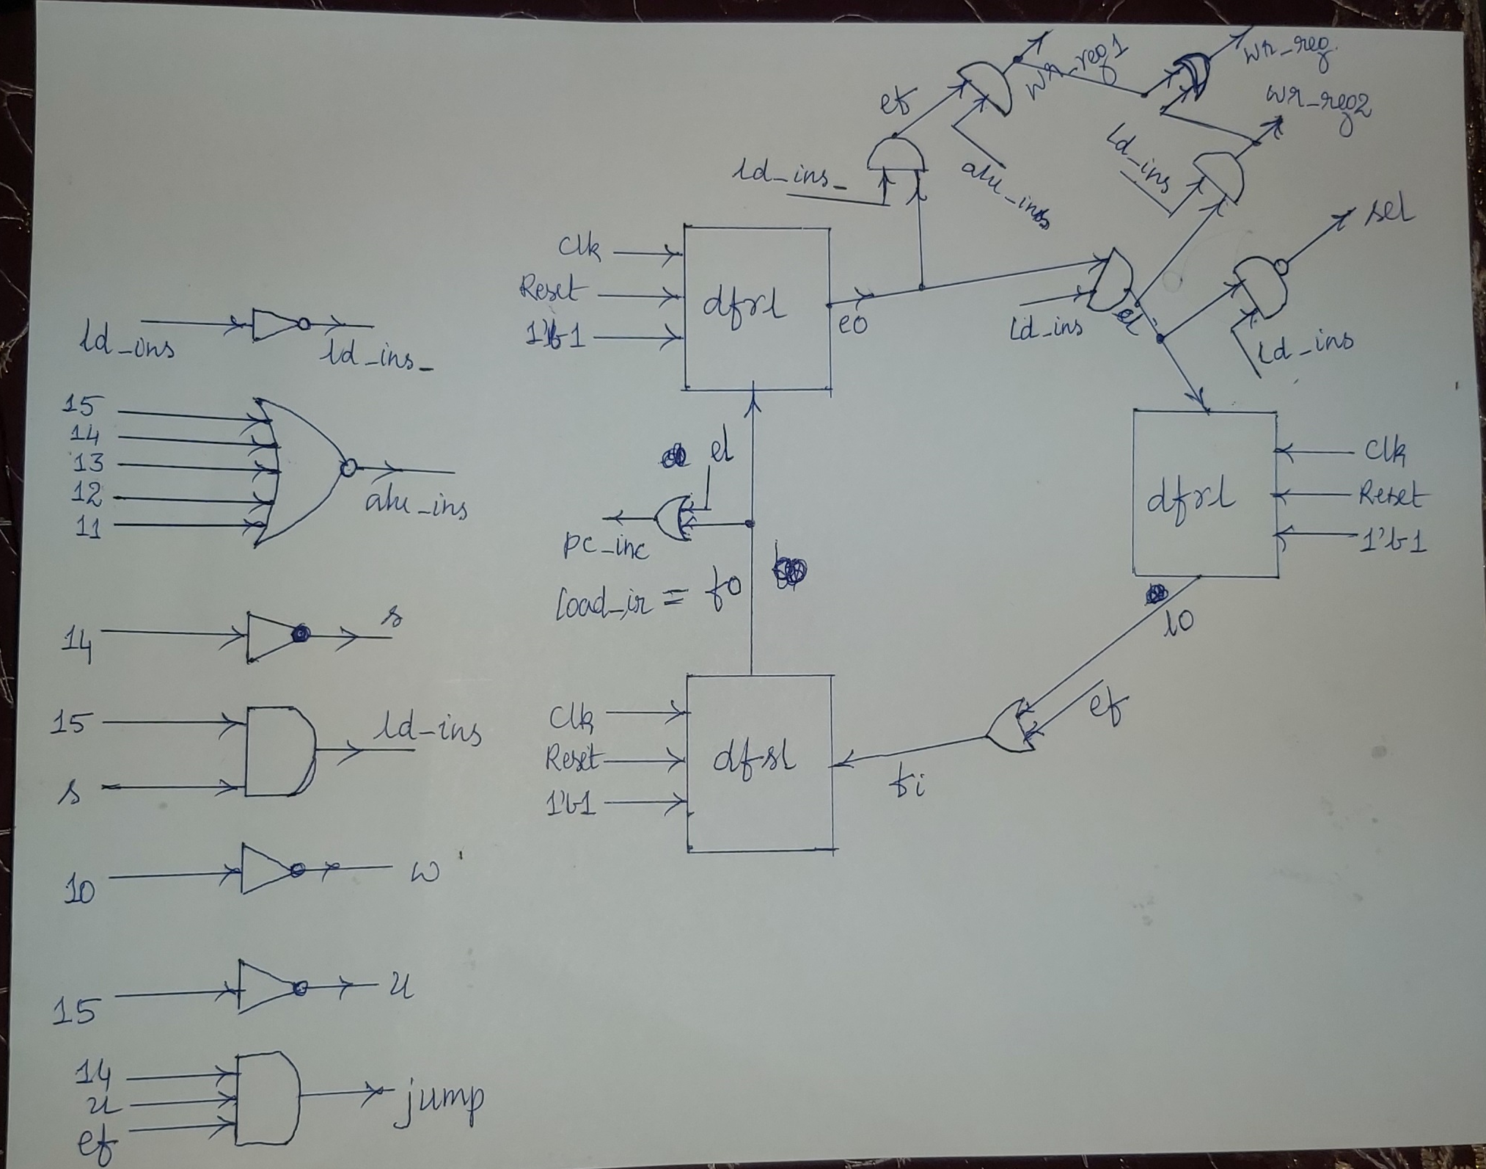

Slide 7
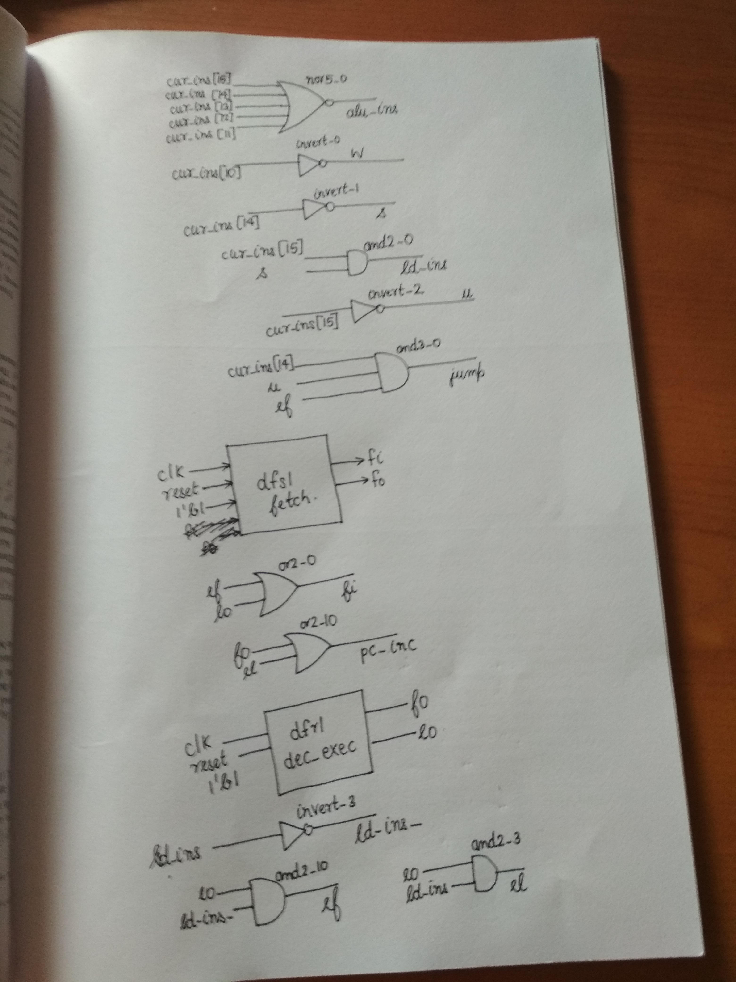

Slide 8
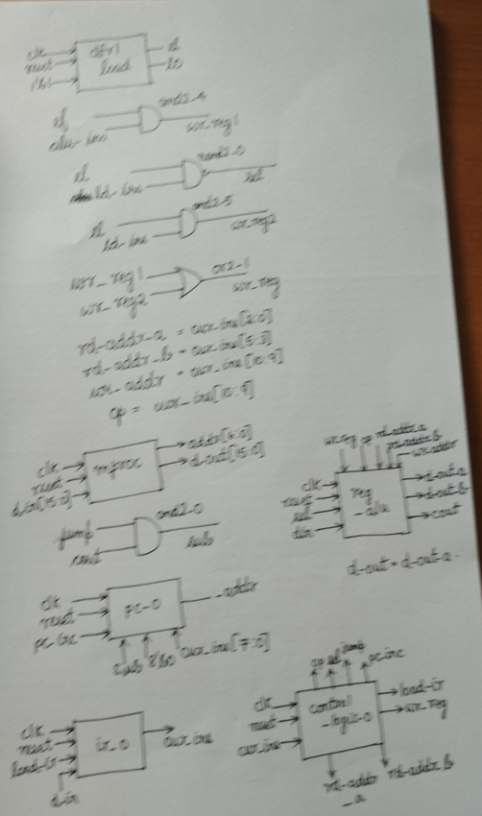

Slide 9
mproc.v Module 1 and 2
module nor5 (input wire [0:4] i, output wire o);
wire t;
or3 or3_0 (---------------------);
nor3 nor3_0 (------------------);
endmodule
module ir (input wire clk, reset, load, input wire [15:0] din, output wire [15:0] dout);

Slide 10
mproc.v Module 3
dfrl dfrl_0 (clk, reset, load, din['h0], dout['h0]);
dfrl dfrl_1 (-----------------------------------------);
dfrl dfrl_2 (-----------------------------------------);
dfrl dfrl_3 (-----------------------------------------);
dfrl dfrl_4 (-----------------------------------------);
dfrl dfrl_5 (-----------------------------------------);
dfrl dfrl_6 (-----------------------------------------);
dfrl dfrl_7 (-----------------------------------------);
dfrl dfrl_8 (-----------------------------------------);
dfrl dfrl_9 (-----------------------------------------);
dfrl dfrl_a (-----------------------------------------);
dfrl dfrl_b(-----------------------------------------);
dfrl dfrl_c (-----------------------------------------);
dfrl dfrl_d (-----------------------------------------);
dfrl dfrl_e (-----------------------------------------);
dfrl dfrl_f (-----------------------------------------);

Slide 11
mproc.v Module 4
module control_logic (input wire clk, reset, input wire [15:0] cur_ins, output wire [2:0] rd_addr_a, rd_addr_b, wr_addr, output wire [1:0] op, output wire sel, jump, pc_inc, load_ir, wr_reg);
wire s, u, w, ld_ins_, ld_ins, wr_reg1, wr_reg2;
wire fo, eo, lo, fi, ef, el;
nor5 nor5_0 (-----------------------);
invert invert_0 (--------------------------);
invert invert_1 (----------------------);
and2 and2_0 (---------------------------);
invert invert_2 (---------------------);
and3 and3_0 (----------------------);

Slide 12
mproc.v Module 4 Cont.
dfsl fetch (---------------------);
or2 or2_0 (-----------------);
or2 or2_10 (--------------------);
//assign pc_inc = fo;
assign load_ir = fo;
dfrl dec_exec (---------------------);
invert invert_3 (---------------------);
and2 and2_10 (-----------------------);
and2 and2_3 (--------------------------);

Slide 13
mproc.v Module 4 Cont.
dfrl load (------------);
and2 and2_4 (------------);
nand2 nand2_0 (------------);
and2 and2_5 (------------);
or2 or2_1 (------------);
assign rd_addr_a = ------------;
assign rd_addr_b = ------------;
assign wr_addr = ------------;
assign op = ------------;
endmodule

Slide 14
mproc.v Module 5
module mproc (input wire clk, reset, input wire [15:0] d_in, output wire [6:0] addr, output wire [15:0] d_out); wire pc_inc, cout, cout_, sub, sel, sel_addr;
wire [2:0] rd_addr_a, rd_addr_b, wr_addr;
wire [1:0] op; wire [8:0] _addr;
wire [15:0] cur_ins, d_out_a, d_out_b;
and2 and2_0 (------------);
pc pc_0 (------------);
ir ir_0 (------------);
control_logic control_logic_0 (------------);
reg_alu reg_alu_0 (------------);
assign d_out = ------------;
endmodule

Slide 15
Design and Simulation
As in previous assignment, the commands to simulate:
iverilog -o tb_mproc_mem lib.v pc.v alu.v reg_alu.v mproc.v mproc_mem.v tb_mproc_mem.v
vvp tb_mproc_mem
followed by waveform observation with the command:
gtkwave tb_mproc_mem.vcd

Slide 16
ram | 15 | 14 | 13 | 12 | 11 | 10 | 9 | 8 | 7 | 6 | 5 | 4 | 3 | 2 | 1 | 0
ram [0] | 1 | 0 | x | x | x | x | x | 0 | 0 | 0 | x | x | x | x | x | x | load r0, 1
ram [1] | 0 | 0 | 0 | 0 | 0 | 0 | 0 | 0 | 0 | 0 | 0 | 0 | 0 | 0 | 0 | 1 | 16’h01
ram [2] | 1 | 0 | x | x | x | x | x | 0 | 0 | 1 | x | x | x | x | x | x | load r1, 21
ram [3] | 0 | 0 | 0 | 0 | 0 | 0 | 0 | 0 | 0 | 0 | 0 | 1 | 0 | 1 | 0 | 1 | 16’h15
ram [4] | 1 | 0 | x | x | x | x | x | 0 | 1 | 0 | x | x | x | x | x | x | load r2, 1
ram [5] | 0 | 0 | 0 | 0 | 0 | 0 | 0 | 0 | 0 | 0 | 0 | 0 | 0 | 0 | 0 | 1 | 16’h01
ram [6] | 1 | 0 | x | x | x | x | x | 0 | 1 | 0 | x | x | x | x | x | x | load r3, 1
ram [7] | 0 | 0 | 0 | 0 | 0 | 0 | 0 | 0 | 0 | 0 | 0 | 0 | 0 | 0 | 0 | 1 | 16’h01
ram [8] | 0 | 0 | 0 | 0 | 0 | 0 | 0 | 1 | 0 | 0 | 0 | 1 | 0 | 0 | 1 | 1 | add r4, r2, r3
ram [9] | 0 | 0 | 0 | 0 | 0 | 1 | 0 | 0 | 1 | 0 | 0 | 1 | 1 | 0 | 1 | 1 | move r2, r3
ram [10] | 0 | 0 | 0 | 0 | 0 | 1 | 0 | 0 | 1 | 1 | 1 | 0 | 0 | 1 | 0 | 0 | move r3, r4
ram [11] | 0 | 0 | 0 | 0 | 0 | 0 | 1 | 0 | 0 | 1 | 0 | 0 | 0 | 0 | 0 | 1 | sub r1,r0,r1
ram [12] | 0 | 1 | x | x | x | x | x | x | 0 | 0 | 0 | 0 | 0 | 1 | 0 | 1 | jbc ram[8]
ram [13] | 0 | 0 | 0 | 0 | 0 | 1 | 0 | 0 | 0 | 0 | 1 | 0 | 0 | 1 | 0 | 0 | move r0, r4

Slide 17
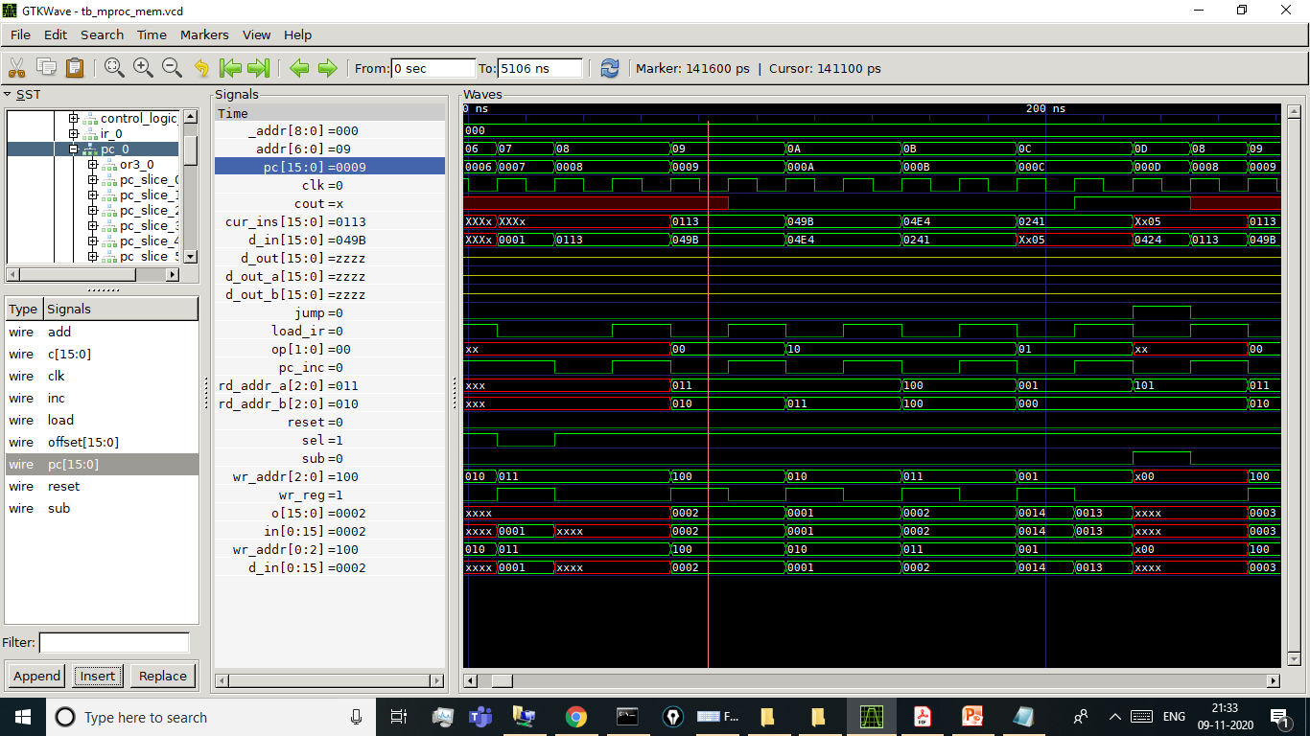

Slide 18
 |  |  | In HEX |  |  |  | In HEX
 |  |  |  | Fibonacci Number 11 | 233 | 89+144=233 | 00E9 H
Fibonacci Number 1 | 2 | 1+1 =2 | 0002 H | Fibonacci Number 12 | 377 | 144+233=377 | 0179 H
Fibonacci Number 2 | 3 | 1+2=3 | 0003 H | Fibonacci Number 13 | 610 | 233+377=610 | 0262 H
Fibonacci Number 3 | 5 | 2+3=5 | 0005 H | Fibonacci Number 14 | 987 | 377+610=987 | 03DB H
Fibonacci Number 4 | 8 | 3+5=8 | 0008 H | Fibonacci Number 15 | 1597 | 610+987=1597 | 063D H
Fibonacci Number 5 | 13 | 5+8=13 | 000D H | Fibonacci Number 16 | 2584 | 987+1597 =2584 | 0A18 H
Fibonacci Number 6 | 21 | 8+13=21 | 0015 H | Fibonacci Number 17 | 4181 | 1597+2584 =4181 | 1055 H
Fibonacci Number 7 | 34 | 13+21=34 | 0022 H | Fibonacci Number 18 | 6765 | 2584+4181 =6765 | 1A6D H
Fibonacci Number 8 | 55 | 21+34=55 | 0037 H | Fibonacci Number 19 | 10946 | 4181+6765 =10946 | 2AC2 H
Fibonacci Number 9 | 89 | 34+55=89 | 0059 H | Fibonacci Number 20 | 17711 | 6765+10946 =17711 | 452F H
Fibonacci Number 10 | 144 | 55+89=144 | 0090 H | Fibonacci Number 21 | 28657 | 10946+17711 =28657 | 6FF1 H

